Slide 1
Team Member
Ahmed Essam
Yasser Toni
Mazen Magdy

Slide 2

Movie Recommendation App
Full-stack project using React

Slide 3
Description
Create an interactive app that provides users with movie recommendations based on genres, trending, and user preferences.
Technologies : React, NodeJS, Redux, HTML5, Tailwind CSS, JavaScript, API Integration.

Slide 4
UI/UX phase
We use Figma to design our Movie App.
Two wireframes have been provided:
Desktop View.
Mobile View.

Slide 5
Technical phase
Front End Repo
To set up our environment we install :
React , Node.js, and Axios library for API calls.
Tailwind for styling, Responsive design, and ensuring toggle theme.
React-icons to import icons we need.
Redux set up for managing global state.

Slide 6
Pages & Components
Header Page which include:
logo
navigation links (component)
search bar (component)
toggle theme (component)
user icon (Sign in – Sign Up)

Slide 7
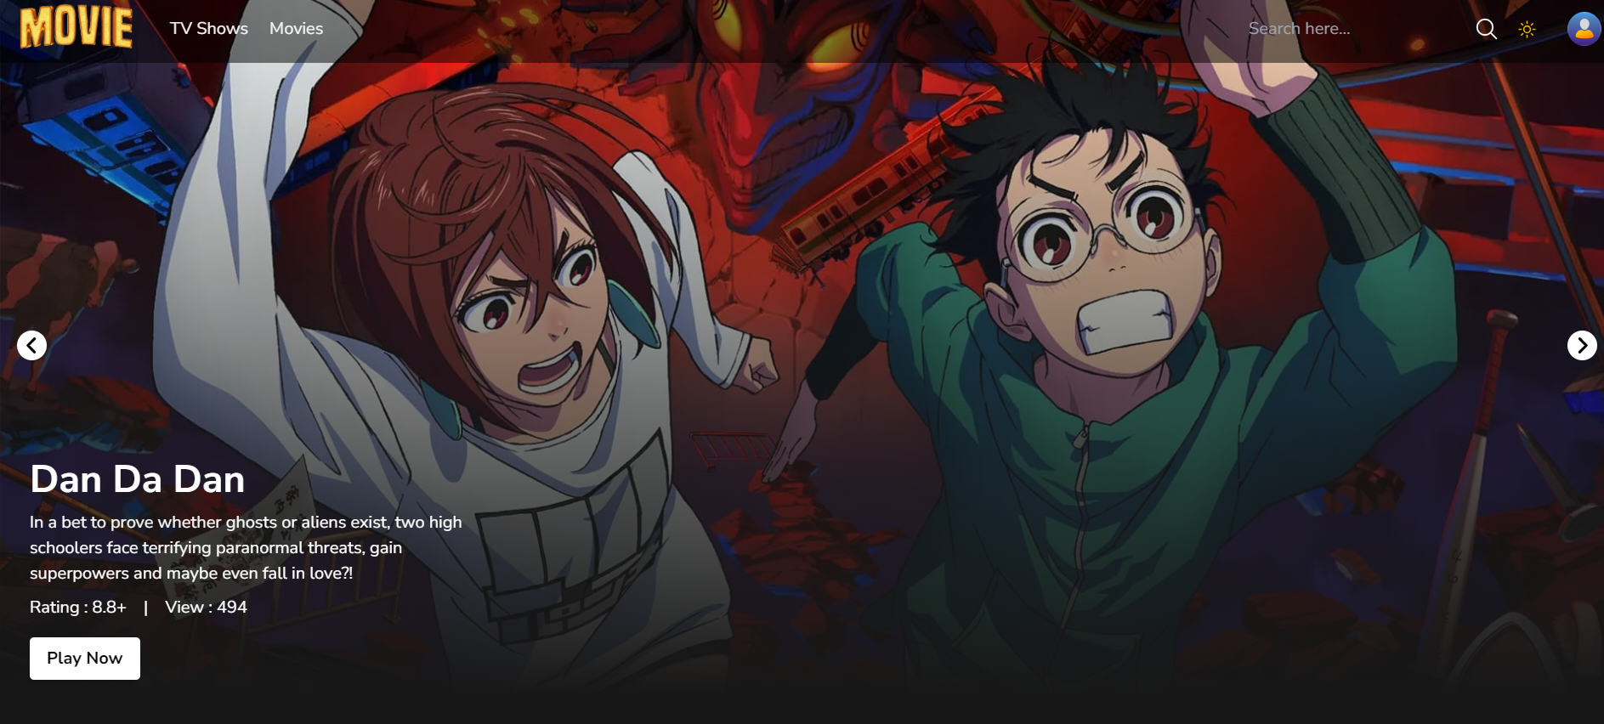
Pages & Components
Home page which include:
Banner component (Data mapping)
Card component which display the movie details
Horizontal scroll card component which maps the data from the API and displays movies data based on their id.

Slide 8
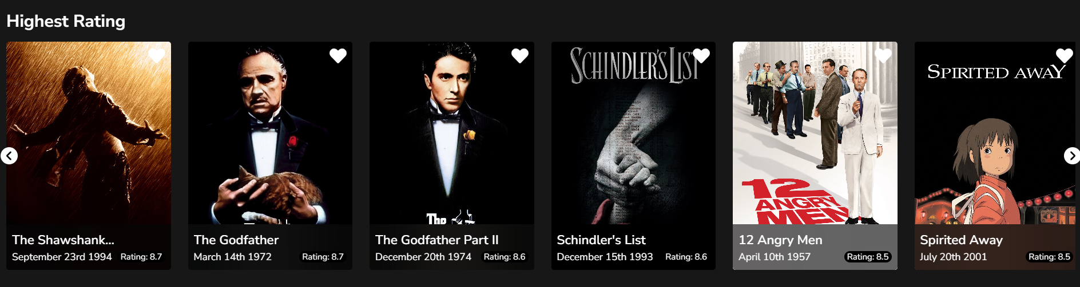
Horizontal scroll card component

Slide 9
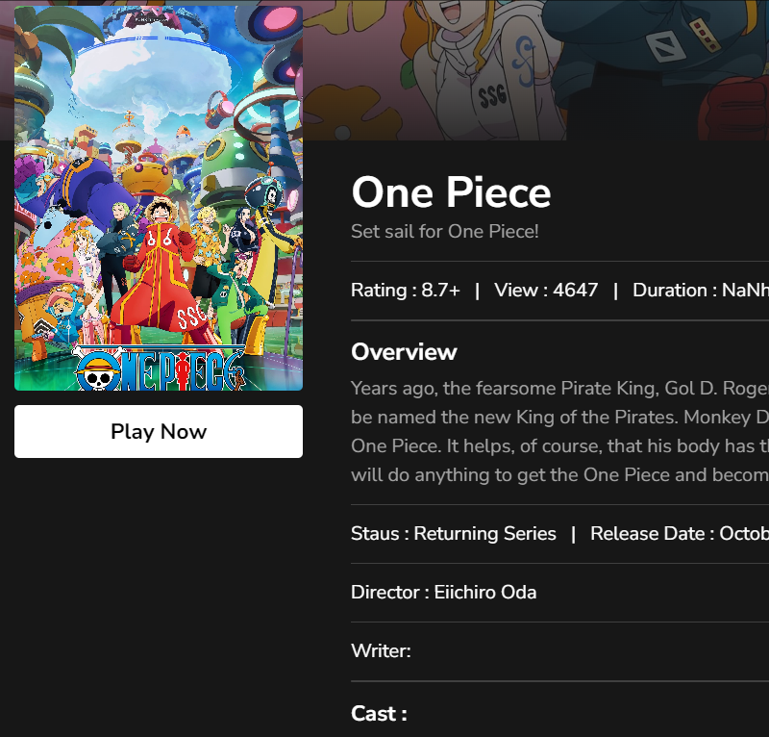
Pages & Components
Details page which include:
More information (Rating—View—Duration –Overview and so on) about the movie which got the user's attention. The page also includes a trailer movie and two lines of similar and recommended movies using the scroll bar component we created.

Slide 10
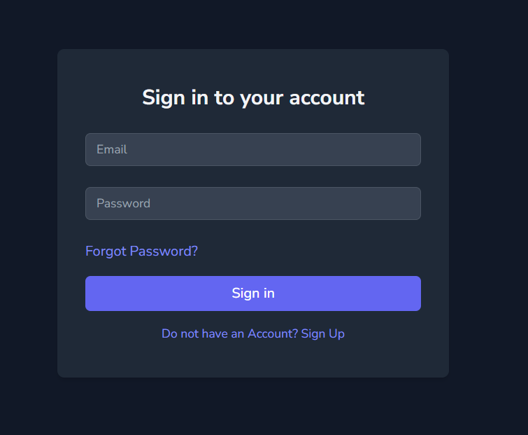
Pages & Components
We created a Login and SignUp form to allow users to access their profile page.

Slide 11
User Profile
We add some feature that allow user to:
Upload profile image
Write user details (Name – Bio - Email)
Add and remove movies from your favorite list

Slide 12
Technical phase
Back End Repo
To set up our environment we install :
Express
MongoDB

Slide 13
Two Types of Data
User Authentication
User Profile
API Documentation with postman which responsible for test the API with pre-configured code snippets

Slide 14
User Authentication
We add features to the user to allow him to :
Sign in
Sign up
logout
Reset password
To reset password, we asking him for three steps which are
Verify reset code by email
enter that code the sent to user email
Write a new password if the last process is successful

Slide 15
User
Attribute Name | Attribute Type
Id* | Number, read only, auto-increment
First Name* | String, required
Last Name* | String, required
Email* | String, required, unique
Profile Image | String
Password* | String, required, at least 5 characters
Password reset code | Number, 6 digits
Password reset expired | Date
Password reset verified | Boolean
Password changed at | Date
Role | [User or Admin]
Active | Boolean
Favorites | [Moved]

Slide 16
Movie
Attribute Name | Attribute Type
Id* | Number, read only, auto-increment
Movie id | Number unique

Slide 17
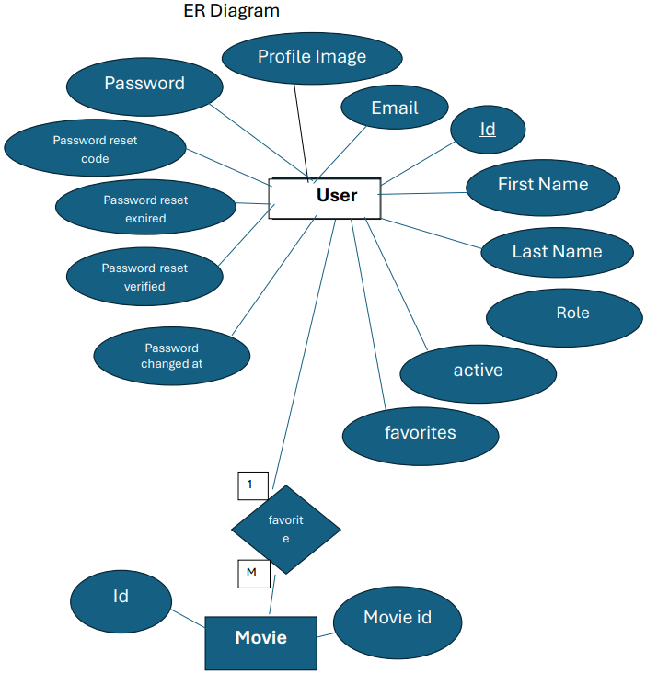
ERD

Slide 18

Thank You

